Slide 1
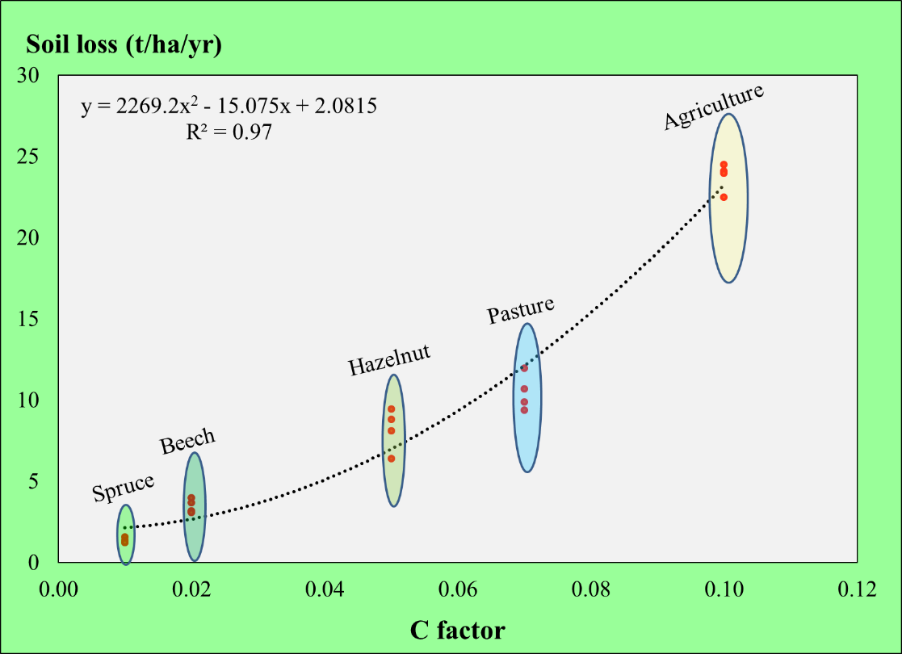
Deforestation Level Alters the Land Use Role in Climate Change and Ecosystem Functions*
Ercan Oktan, Ugur Kezik*, Sezgin Hacisalihoglu
Karadeniz Technical University, Faculty of Forestry, 61080 Trabzon, Turkey
*Some part of results were published in FEB (31/02, 2239-2249, 2022)
«The Biological Reclamation and Monitoring of Disturbed Lands « September 12–16, 2022

Slide 2
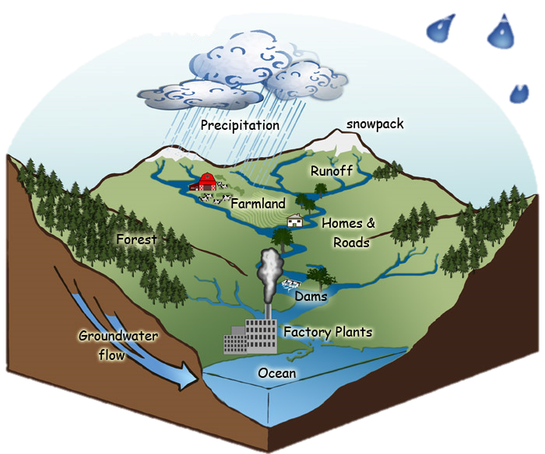
Introduction
Land Use Effects
The main land use forms, in a watershed, such as agriculture, forest and pasture are assessed for ecosystem services. When these forms are proportionally optimum, products and services will be maximum for ecosystem needs.
https://www.satc.org.in/category/watershed-management/

Slide 3
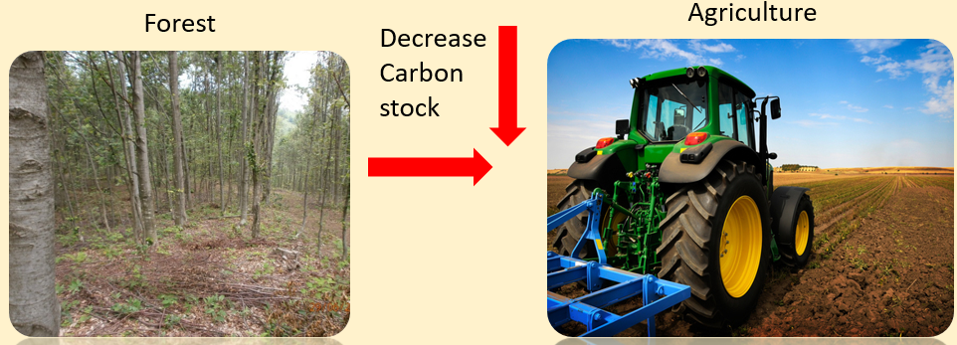
Introduction
Land Use Effects
Unplanned and irregular changes as deforestation and degredation in land uses affect ecosystem functions, adversely.
There is a strong relationship between land use pattern and carbon stock potential (Twesigye, 2011).
Total Carbon stock will be decrease if forest area converted into the agricultural area (Inoue, et al. 2010; Pascual, 2005).

Slide 4
Introduction
Land Use Effects
Carbon stock potential has an important effect on environmental problems like soil erosion and climate Change
(Plante and Conant, 2014).

Slide 5
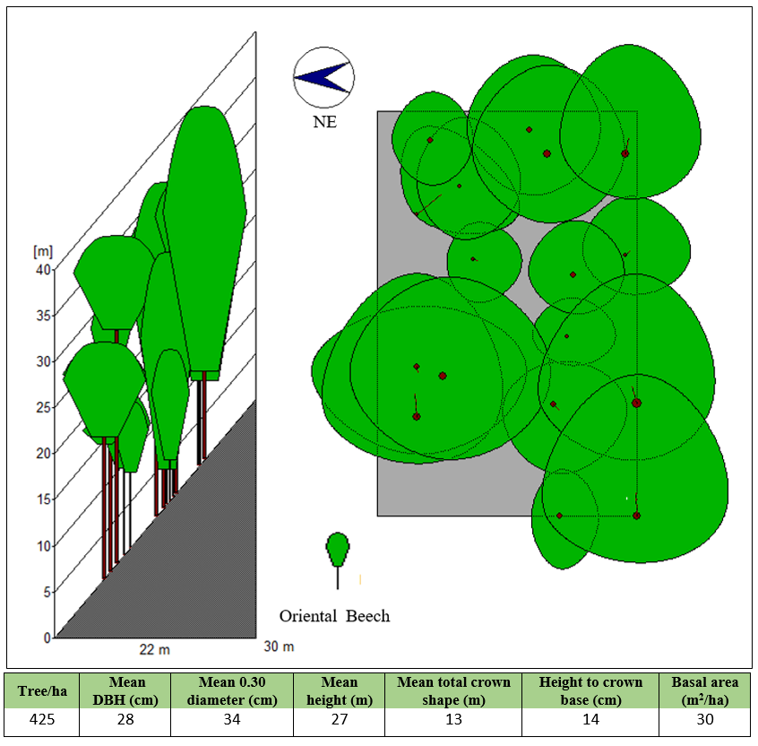
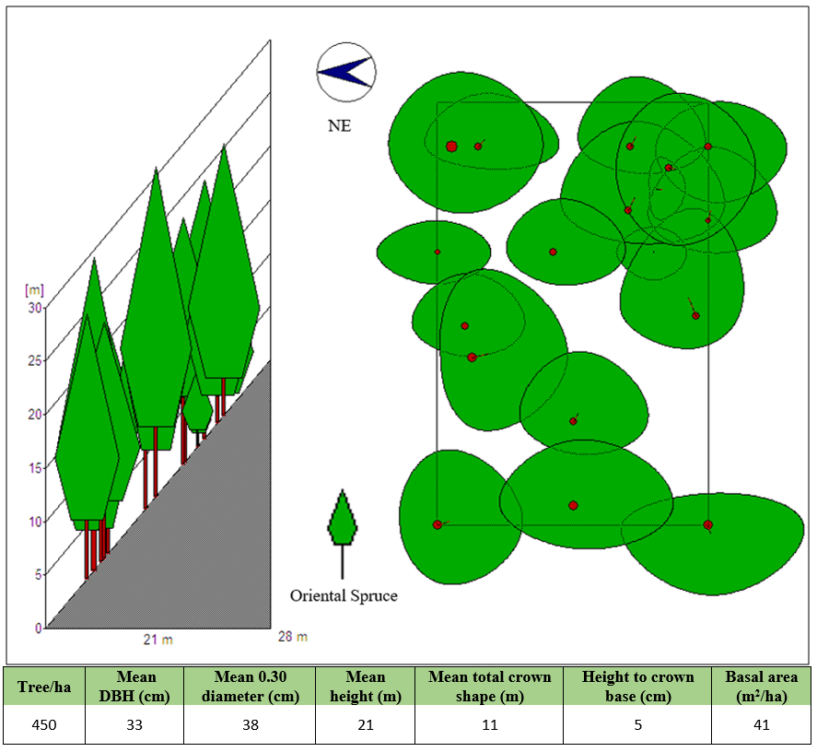
Introduction
Beech
Spruce
In this study, the ecological impact levels on carbon stock and soil erosion resulted from converted into in the last 40 years pasture, hazelnut and annual agricultural (cabbage) areas of Oriental Spruce and Oriental Beech forests.

Slide 6
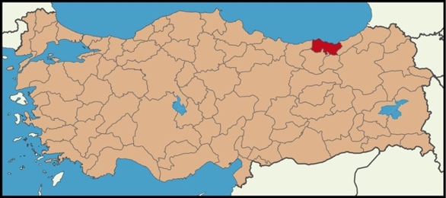
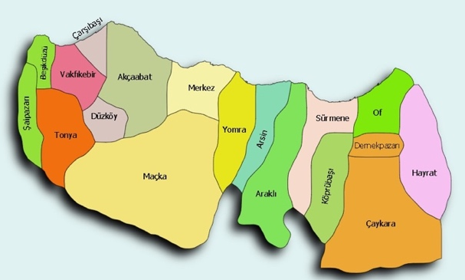
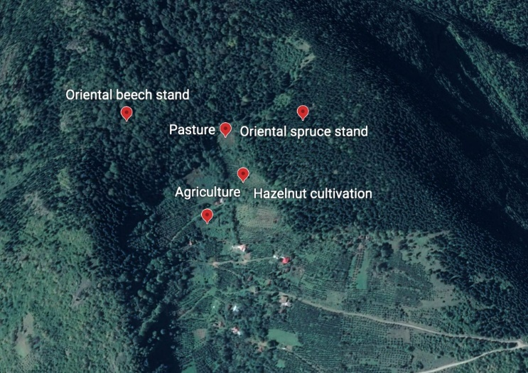
Metarial & Methods
Trabzon
TURKIYE
Five sample plots were selected (20 m x 20 m in size) from different land use types in the study area.
Two soil profiles were opened in each sample plots. In this way, totally 10 soil profiles were opened and in total 20 soil samples were taken from two different soil depth (0-20 cm; 20-50 cm) in each soil depth for further analysis.
Physical, chemical and hydrological analyses were carried out on each soil sample in the laboratory.
Study Area

Slide 7
Material & Methods
Soil Loss Equation
A = R.K.LS.C.P
Soil Loss Equation
A=is the average annual soil loss (t/ha per year)
R= the rainfall erosivity factor
ABAG (Allgemeine Boden Abtrags Gleichung) (Schwertmann et al. 1990) simulation model modified from USLE (Universal Soil Loss Equation) (Wischmeier & Smith 1978) was used in soil loss accounting.
K= the soil erodibility factor
L= the slope length (m)
S= the slope (%)
LS= Topographic factor
C= the cover management factor
P= the supporting practice factor (terracing)
Factors Affecting Soil Loss
Climatic
Protective
prevention
Edaphic
Topographic
Vegetative
http://theconversation.com/oecd-coal-discussions-highlight-tensions-in-australias-position-on-climate-change-50522

Slide 8
Material & Methods
Soil Carbon Stock
$SOCS=BD×C \%×D$
(Guo and Gifford, 2002).
SOCS: Soil organic carbon stock (t ha⁻¹ )
BD: Bulk density (g cm⁻³),
C: Organic carbon (%) (Walkley black)
D: Soil sampling depth (cm)

Slide 9
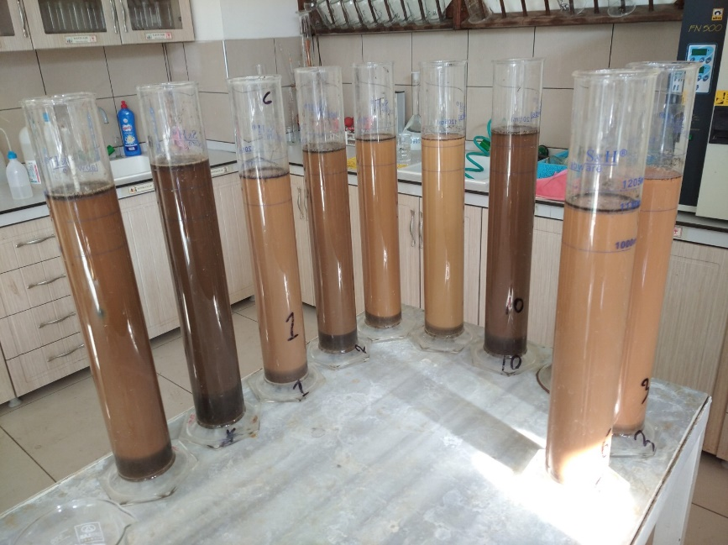
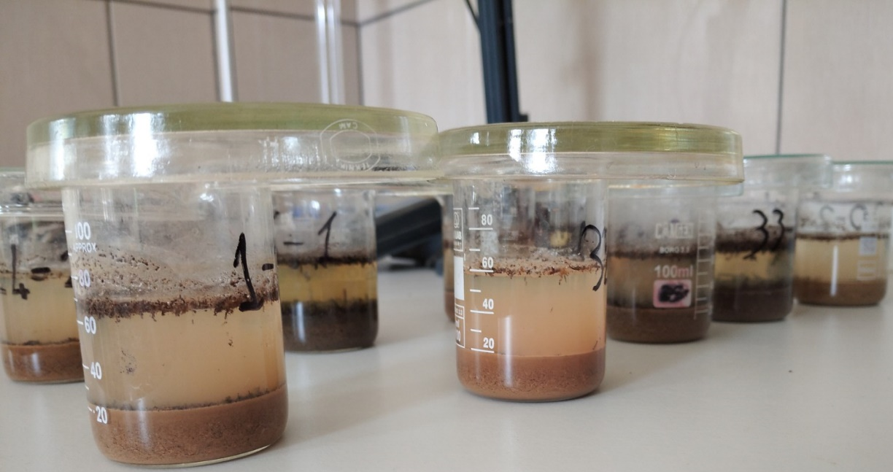
Material & Methods
Particle size analysis
Organic matter
Hydraulic concductivity
pH
Bulk density
Electrical concductivity (EC)
Total Dissolved Solid (TDS)
Wilting point
Saturation
Field capacity

Slide 10
Results & Discussions
Soil texture (0-50cm) according to land use type. (Mean ± SE, p<0.05, n=4)

Slide 11
Results & Discussions
OM (organic matter), pH and BD (bulk density) (0-50cm) according to land use type. (Mean ± SE, p<0.05, n=4)

Slide 12
Results & Discussions
WP (wilting point), FC (field capacity) and Saturation (0-50cm) according to land use type. (Mean ± SE, p<0.05, n=4)

Slide 13
Results & Discussions

Slide 14
Results & Discussions

Slide 15
Conclusions
After Deforestation
Significant changes have occurred in most soil properties as well as SOCS and soil loss by land conversion.
With the conversion of the land that was previously a spruce forest into agricultural area, the amount of erosion has increased approximately 18 times.
After hazelnut plantation, the amount of erosion has increased approximately 6 times.
If these agricultural areas were converted from beech forest, the amount of erosion would have increased approximately 7 times in agricultural area and approximately 2 times in the hazelnut area.
These values ​​have been an indicator of how much deforestation will contribute to the more devastating effects of climate change in the future.

Slide 16
Thank you!

