Slide 1



CAN CLONE INDIVIDUALS FROM MONUMENTAL TREES BE USED IN DEGRADED AREAS?
Ercan OKTAN Neslihan ATAR
Forestry Faculty, Karadeniz Technical University, Trabzon, TR-61080, Turkey
Forestry Faculty, Artvin Çoruh University, Artvin, TR-08100, Turkey
XI All-Russian Scientific Conference with International Participation
“The Biological Reclamation and Monitoring of Disturbed Lands”
September 12–16, 2022

Slide 2
PURPOSE OF THE RESEARCH
In the study, it is aimed to reveal the strategy of protecting monument trees as genetic resources and using them in deteriorated areas in the world.
Monumental trees;
Being resistant to environmental changes,
their contribution to biodiversity,
ecological and biological values ​​and contributions,
their small amount in forests and the necessity of ensuring their continuity, etc. issues highlight their importance.
For this reason, our study includes information about the necessity of protecting these unique assets and the literature studies carried out in order to reveal the benefits of clones obtained from these trees in the improvement of degraded areas.

Slide 3
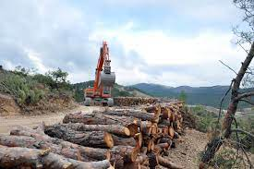
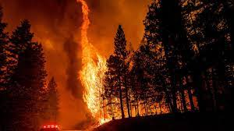
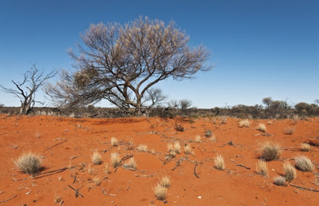
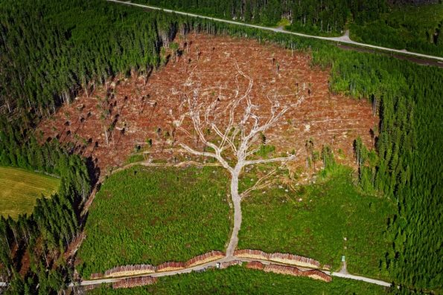
1. Degraded Forest Lands
It is estimated that more than 2000 million hectares of the world’s forest have been degraded. As indicators of a degraded ecosystem can be shown decrease in biodiversity and productivity, loss of value in soil structure and micro-environment.
A disturbed ecosystem refers to a supernatural system that is formed under natural or human-induced pressures. The primary causes of forest degradation are unsustainable exploitation wildfires, overgrazing, and the spread of invasive species or pests. In addition, sudden changes in the climate cause negative changes in vegetation and its distribution, accelerating the land degradation process and revealing new degradation patterns (permafrost thaw or biome shifts).Continuing land degradation triggers climate change through greenhouse gas emissions and reduced carbon uptake rates.
It is urgently necessary to take advantage of natural recovery mechanisms to prevent irreversible degradation of the world and to preserve the multiple values ​​of productive land. For this purpose, afforestation and rehabilitation are the most reliable methods to restore land productivity in such areas.
In this study, the adaptation of these clones to degraded areas in the world will be evaluated by using clones of monumental trees, which provide numerous beneficial ecosystem services for the development of all life forms.
Fig. 1 Unsustainable exploitation
Fig. 2 Wildfires
Fig. 3 Desertification

Slide 4
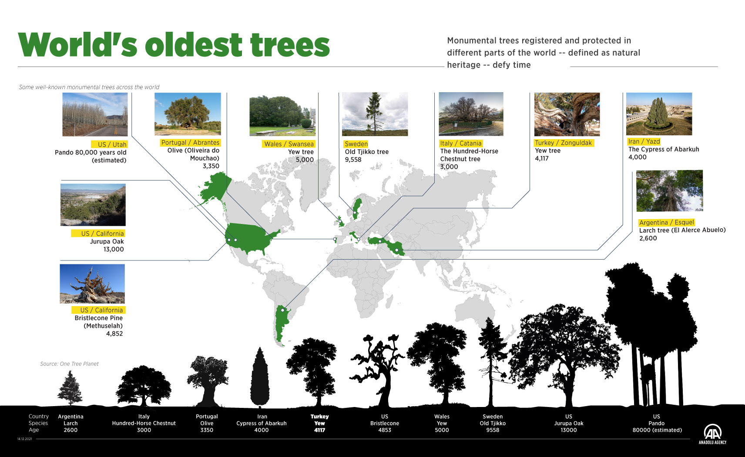
Monumental trees are some of the most iconic biota on earth and are integral parts of many terrestrial ecosystems including those in tropical, temperate and boreal forests, deserts, savannas, agro-ecological areas, and urban environments.
WHY MONUMENTAL TREE?

Slide 5
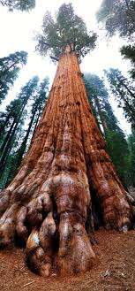
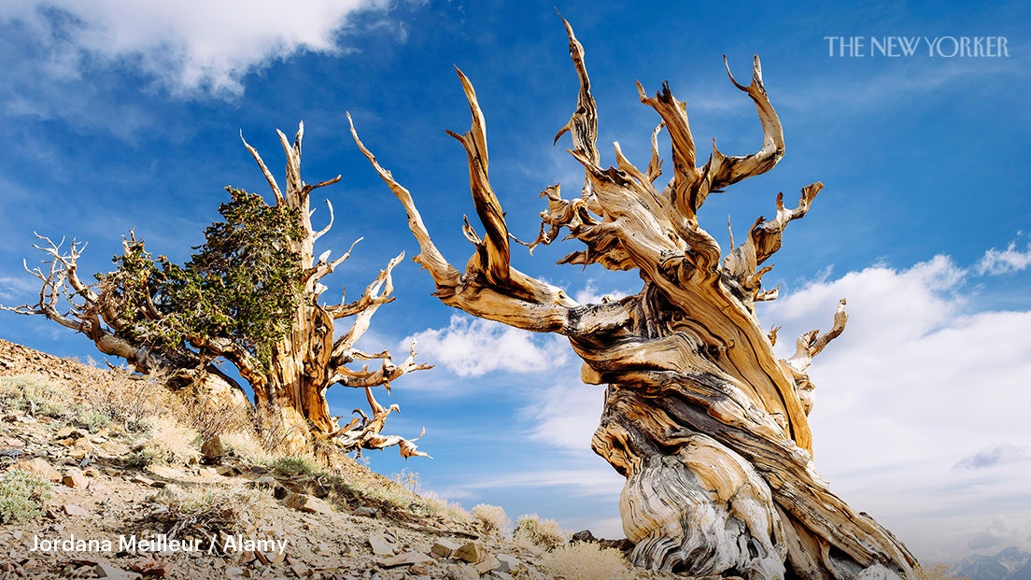
Among these trees, Monument Great Basin Bristlecone pines grew in rocky harsh field conditions, while Giant sequoia (Sequoiadendron giganteum) reached monumental dimensions in fertile field conditions. (Fig.4-Fig.5). Thus, the two most famous of oldsters, whose natural ranges are separated by just a few miles, follow divergent strategies for living a long time.
Fig.4 Monument Great Basin Bristlecone pines
Fig. 5 Giant sequoia (Sequoiadendron giganteum)

Slide 6
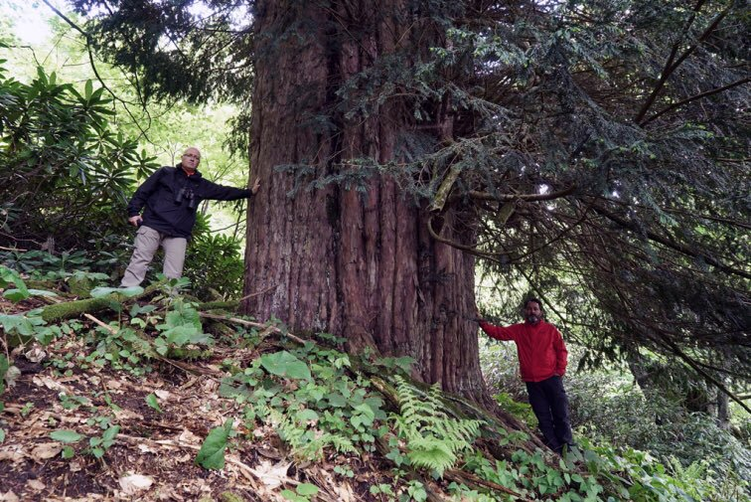
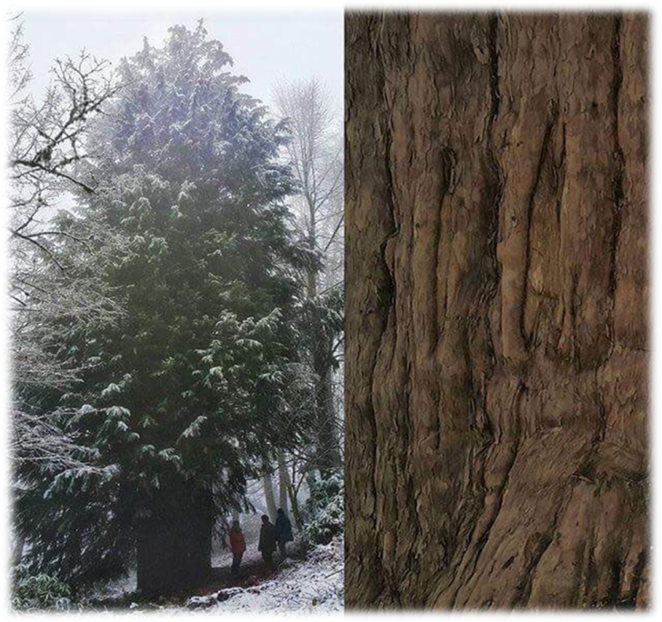
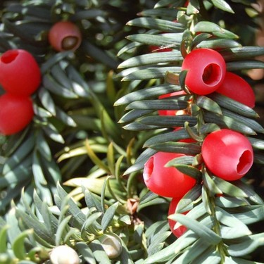
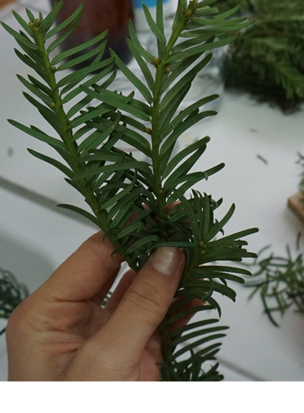
WHY MONUMENTAL TREE?
1. The most important creatures that adapt to the changing and developing climate in the world are the monumental trees in the forests. It has different mechanisms that improve land efficiency and productivity by adapting to the extreme or degraded conditions of the area it is in. These trees have survived in many stages, from all kinds of climate changes to changes in the surrounding stand structure, in their growth environment for thousands of years. Mature forests and trees are important tools in the fight against desertification, they are in many cases the only creatures standing against the unstoppable advance of the desert.
2. They are in harmony with the ecosystem in which they live and have features that help control soil erosion, such as deep rooting or low water use.
3. They are singled out by age, their small numbers and restricted distribution, regardless of the priority of its species, being confers as guarantors of the provision of seeds and vegetative material very suitable, with which contribute to natural forest regeneration (Fig.7).
COMMON YEW(Taxus baccata L.)
Age: 4118
Length(m): 25.50
Ç1.30(m): 7.70
D1.30(m): 2.45
MONUMENTAL QUALİTY
Age and Diameter
Fig. 6 Turkey –Yew (Taxus baccata L.)- 4118
Fig. 7 Seed and vegetative material of the monument Yew tree

Slide 7
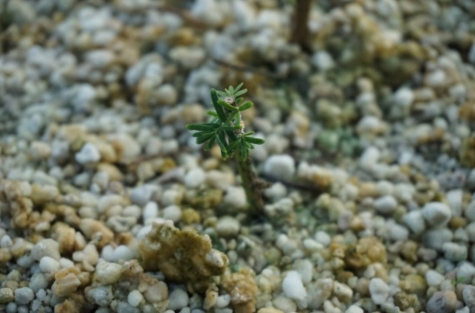
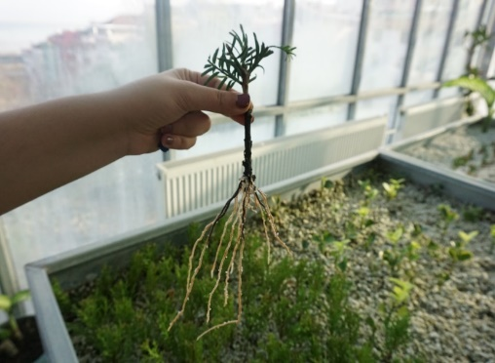
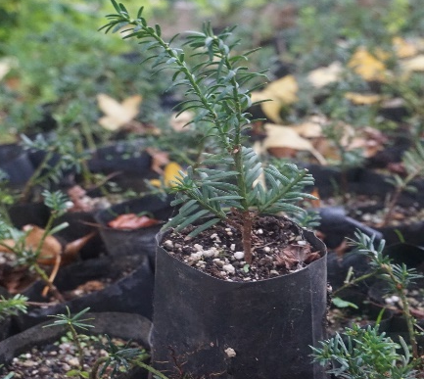
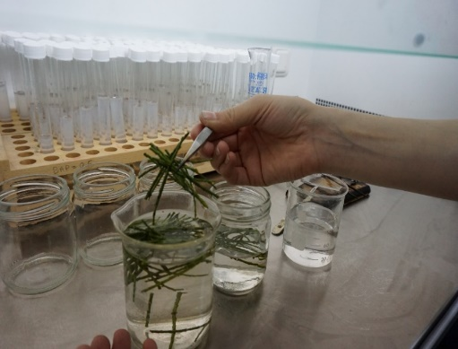
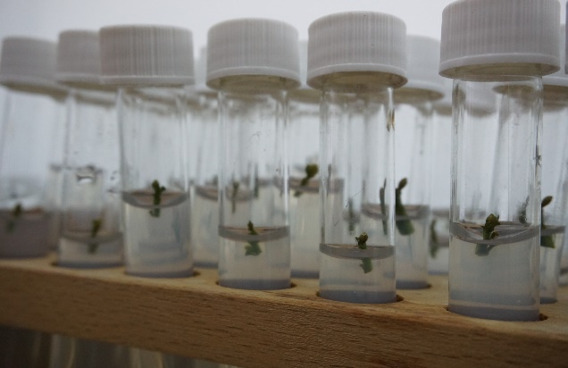
4. Under the global change, it is urgently necessary to protect monumental trees with superior genetic characteristics by various biotechnological methods (ex-situ-in-situ) and to relocate them to their natural areas. In recent years, plant tissue culture and cutting propagation methods, which are ex-situ conservation methods, have been started to be used in the reproduction of monumental trees (Fig.8-Fig.9). Old trees are generally preferred for cloning. Because a person can select trees that have existed long enough to show their superior values ​​in their field. Studies show that many problems are encountered in the production of individuals with monumental tree characteristics. This shows that research and development studies in propagation methods should be continued in order to take full advantage of the cultivation opportunities of these trees.
Fig.8 Monument Yew in cutting production
Fig.9 Monument Yew in vitro production

Slide 8
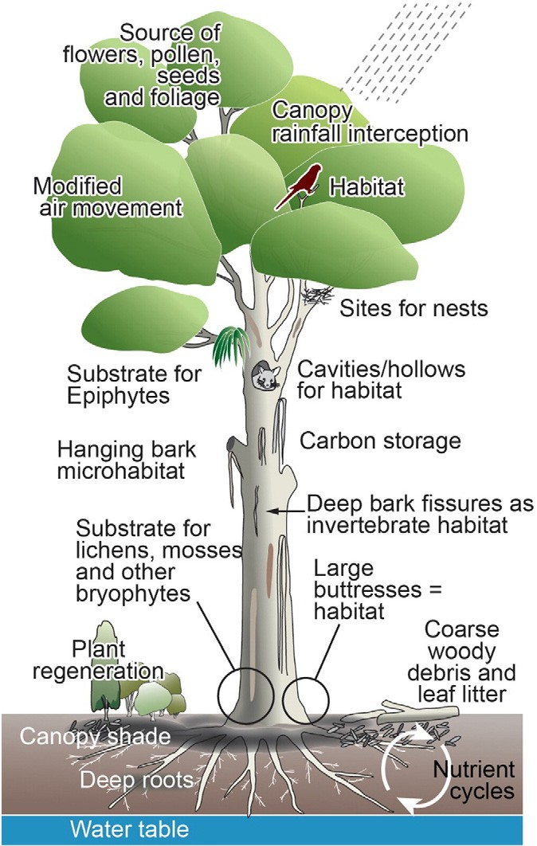
WHY MONUMENTAL TREE?
5. In many ecosystems globally, large old trees occur as single, spatially isolated individual trees or as small groups of scattered trees and can therefore be considered to be small natural features. Despite being constrained spatially, individual large old trees and small stands of such trees nevertheless play numerous critical ecological roles. These include roles in ecosystem processes such as hydrological regimes, carbon storage and nutrient cycling, micro- and meso-climatic regimes, and providing habitat for an enormous array of plant and animal species (Fig. 10)
Fig. 10 Schematic representation of a subset of the array of ecological roles played by large old trees.
As a Result;
Both the current observed climate change and the possible future climate change predictions make it difficult to reach precise information about a deterioration in the world climate system and where this deterioration will take us. The extent to which these trees can tolerate sudden climate change is of vital global concern. At the same time, the destruction of trees is irreversible. Because it is possible for plant gene sources to disappear under natural disasters that may occur due to various reasons.
In this way, the genetic and physiological heritage of the monumental trees, which form a unique habitat for nature, will be preserved. It is necessary to include afforestation in order to preserve genetic diversity and to ensure that the genetics of monument trees are mixed with different trees. In order to preserve and maintain genetic diversity in these areas, attention should be paid to monoculture and clones from different monumental trees should be used whenever possible. The genetic power of the clones obtained from these trees will contribute to the improvement of the areas where they are planted. In addition to this, ex-situ conservation of monumental trees can be ensured by transferring genetic diversity to another area through clones of monumental trees.

Slide 9
THANK YOU FOR YOUR ATTENTION.

